Slide 1

Vector Institute
Driving excellence in machine learning and deep learning
December 2018

Slide 2

Atypical & Exciting Collaboration
The Vector Institute is an independent not-for-profit corporation dedicated to advancing the field of artificial intelligence through world-class research and applications in the areas of deep learning and machine learning.
Vector serves as the pillar of a thriving AI ecosystem by combining the strengths of institutions, enterprises, start-ups, and business incubators to help drive AI research and its adoption and commercialization across Canada.
Launched in partnership with the University of Toronto and with unprecedented funding and collaboration between governments and businesses across the Canadian economy
Located in the Toronto-Waterloo innovation corridor, which employs 205,000+ tech workers, second only to Silicon Valley in North America

Slide 3

Canadian Context
Canada has been a leader in AI research and education for years, specifically in the fields of deep learning, machine learning and reinforcement learning.
Major AI research and investment clusters have emerged around leading scientists and academic institutions in Toronto, Montreal and Edmonton.
Robots controlled by remote supercomputers. Self-driving cars on narrow, winding streets. Board-game players of unimaginable skill. These successes of artificial intelligence (AI) rely on neural networks: algorithms that churn through data using a structure loosely based on the human brain, and calculate functions too complex for humans to write. The use of such networks is a signature of firms in Silicon Valley. But they were largely invented not in California but in Canada.
- The Economist, November 2017
EDMONTON
MONTREAL
TORONTO

Slide 4
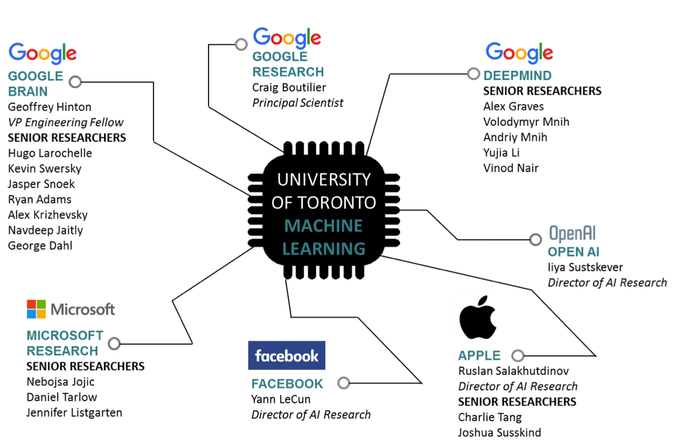
Graduates from Canada: Highlights
Graduates from Canada have gone on to lead labs in the world’s top technology companies.
Craig Boutilier
Principal Scientist
SENIOR RESEARCHERS
Alex Graves
Yujia Li
James Martens
Volodymyr Mnih
Andriy Mnih
Vinod Nair
Yee Whye Teh
Geoffrey Hinton
VP and Engineering Fellow
SENIOR RESEARCHERS
Ryan Adams
George Dahl
Navdeep Jaitly
Alex Krizhevsky
Hugo Larochelle
Jasper Snoek
Kevin Swersky
Daniel Tarlow
Ilya Sutskever
Co-founder & Research Director
Nebojsa Jojic
Principal Researcher
Jennifer Listgarten
Ruslan Salakhutdinov
Director of AI Research
SENIOR RESEARCHERS
Joshua Susskind
Charlie Tang
Yann LeCun
Director of AI Research

Slide 5
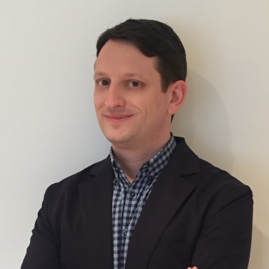
The Great AI Awakening
Companies, governments and institutions in Canada are awakening to the opportunities presented by investments in AI and the quality of local talent.
All organizations are at different stages of realizing the power of AI and adapting their strategies to seize the opportunities presented by the future of AI research and applications.
Whether it’s in corporate research labs, hospitals, traditional industry or innovative start-ups, the local demand for AI talent is greater than ever.
Recognizing this immense opportunity, Canadian academics, governments and businesses came together in an unprecedented collaboration to launch the Vector Institute earlier this year.
The Vector Institute and its partners will play a major role in meeting the demand for talent.
Vector is combining strengths across Canada’s thriving AI ecosystem and building a complete AI value chain.
“An informal survey of companies in Toronto and the surrounding area found that local companies want to hire thousands of machine learning PhDs and Master's graduates in the next five years. This number is far greater than the number of graduates per year in all of Canada and that helped to validate the idea to create the Vector Institute.”
Jordan Jacobs, CEO, Layer 6 AI, Co-founder, Vector Institute

Slide 6
Vector: Vision & Mission
Vision
Vector will drive excellence and leadership in Canada's knowledge, creation, and use of artificial intelligence to foster economic growth and improve the lives of Canadians.
Mission
Vector will lead Ontario’s efforts to build and sustain AI-based innovation, growth and productivity in Canada by focusing on the transformative potential of deep learning and machine learning.
Vector, together with its AI partners in other parts of Canada, will work with Canadian industry and public institutions to ensure that they have the people, skills, and resources to be best in class at the use of artificial intelligence.
Vector will support Canada's innovation clusters in artificial intelligence and focus on helping start-ups grow to become Canadian-based global leaders.
Vector will attract the best global talent focused on research excellence; Vector’s researchers and academic partners will be part of a vibrant community of innovative problem solvers, working across disciplines on both curiosity-driven and applied research.

Slide 7

Why Now?
The possibilities, potential, and applications of AI are evolving rapidly, encompassing every industry.
AI is an area of scientific, academic, and commercial endeavour that will shape our world over the next generation, bringing changes large and small and in every facet of our lives from business to personal, from professional to leisure.
Organizations across Canada must be a part of the transformation and lead innovation, because the risks of not participating are simply too high.
Companies have a choice when faced with disruptive change: to react or proactively seize opportunities and contribute to a solution.
We have an opportunity to combine our strengths and build on the strong foundation of research in Canada.
There is global demand for AI talent; the cost and competition for this talent is high. Canadian governments and businesses have recognized the need to invest in AI and the local talent pool. They have come together in an unparalleled collaboration to support the creation of the Vector Institute and address challenges and opportunities.

Slide 8
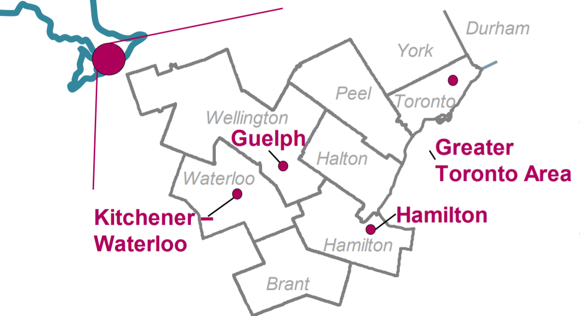
Vector is Part of a Thriving Ecosystem
Located in Toronto, Ontario the Vector Institute is in one of three major AI centres in Canada.
Toronto is Canada’s most populous city and the fourth largest city in North America.
Ontario is home to more than 200 AI-enabled firms with a total of $2.84B raised in 2016.
The Toronto-Waterloo innovation corridor employs 205,000+ tech workers, second only to Silicon Valley in North America.
Toronto-Waterloo Corridor
High concentration of AI start-ups, enabled by a strong start-up community, AI-focused incubators, and investors.
Toronto is Canada’s financial capital; the city has the second-highest concentration of large bank headquarters in the world and accounts for more than $1.5 trillion in institutional investor capital.
Multi-national corporations are also taking notice and expanding their R&D labs in Ontario including: General Motors, Google Brain, RBC’s Borealis AI, Thomson Reuters Technology Centre, Uber ATG
Ontario is home to world-leading medical and health systems research.
Sources:
https://www.nextcanada.com/images/TechNorth-McKinsey-Report.pdf; Deloitte, Enabling Technologies, November 2016; Toronto Region Response to Amazon HQ2 RFP; Toronto Global

Slide 9
Funding: Sources and Uses
Funding sources: $135 million in the first five years*
Federal funding through the Canadian Institute for Advanced Research (CIFAR) to support the Canada CIFAR AI Chairs Program, graduate training, institute operations, and the participation of the Chairs and trainees in national AI activities.
Provincial funding from the Government of Ontario to establish the institute, deliver core programming, and support the development of the AI ecosystem.
Industry sponsorships: Nearly 40 large, medium, and small companies collaboratively supporting a world-class research centre with expectations of access to research ideas and growth in the AI workforce.
Vector’s priorities and activities are therefore focused on establishing a strong foundation for research excellence and receptor capacity for talent and ideas.
This includes growing and retaining a team of world-class Vector Researchers and supporting their research through the provision of computing resources, and funded students and postdoctoral fellows.
*Total does not include funding announced by the Government of Ontario to facilitate work with academic institutions across the province towards the goal to graduate 1,000 professional applied Master’s students in AI-related fields in Ontario per year within five years.

Slide 10
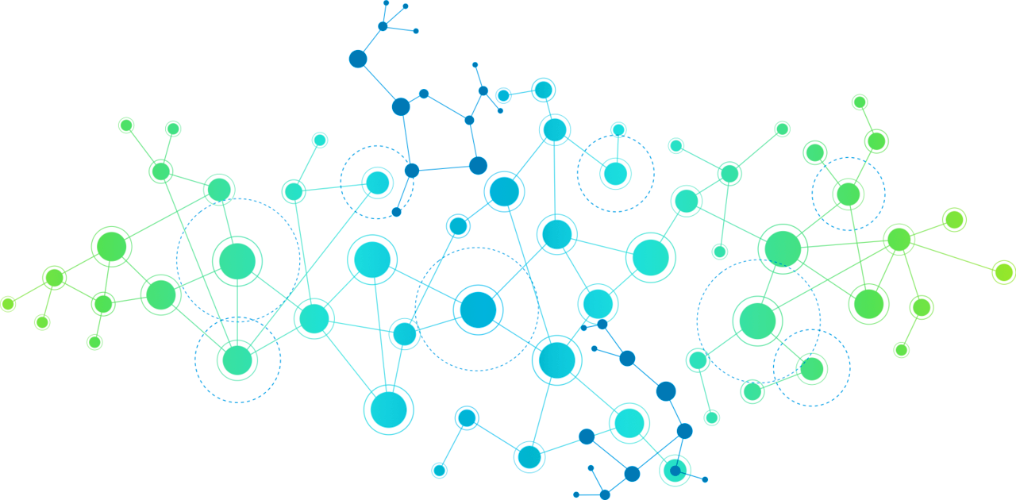
Vector Engages a Growing Canadian AI Ecosystem
In addition to working closely with its funding partners, Vector is building strategic relationships and connections among leading organizations whose expertise can help advance Vector’s vision and mission.
Incubators
Creative Destruction Lab
Next AI
Communitech
MaRS Innovation
OneEleven
Start-up Networks & Supports
Ontario Centres of Excellence
Ontario Network of Entrepreneurs
Government of Canada
Canadian Institute for Advanced Research
Government of Ontario
Ministry of Economic Development Job Creation and Trade
Canadian Universities* and Research Institutions
Vector’s Industry Sponsors
35 large, medium and small companies from across sectors
VCs
Georgian Partners
iNovia
Real Ventures
Relay Ventures
Medical and
health systems researchers & institutions
Other Leading Canadian AI Institutes
Amii
Mila
*Special thanks to the University of Toronto for providing administrative, operational, and policy support to assist in the launch of the Vector Institute.

Slide 11





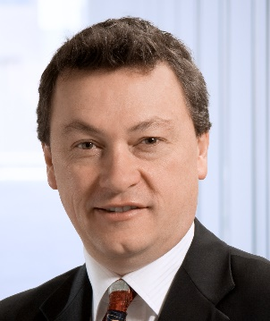
Vector Activities
Increasing the supply of AI talent by training more students, training industry professionals, and presenting opportunities for the two to network.
Combining strengths across the innovation ecosystem in Toronto and Canada by bringing together universities, governments, start-ups, scale-ups, incubators, accelerators, VCs, and enterprises.
Providing flexibility for researchers to pursue work in an environment that is focused on both pure and applied research.
Vector will work with Ontario’s world-renowned medical research centres on projects that will increase the accessibility of health data to world-class machine learning researchers, enabling the widespread application of machine learning in health care.
Leveraging Canada’s strong history of AI research to continuously attract new talent and new investment, thereby boosting the knowledge economy.
“The establishment of the Vector Institute has generated great interest and excitement, spurring interest from industry and attracting top global talent in machine learning and deep learning. Canada has the potential to become a global leader in advancing AI research, development and commercialization, and all of Canada stands to benefit as a result. I’m a proud Canadian who graduated from the University of Waterloo. I am excited about returning home to help lead these efforts with the Vector Institute.”
- Garth Gibson, President & CEO
11

Slide 12
Specialization in Deep Learning
  Generally speaking, artificial intelligence refers to computers that can learn about the world flexibly, make inferences about what they see and hear, and achieve human-like understanding of information. Artificial intelligence involves capacities like visual and auditory perception, the ability to read and to make sensible decisions, and the power to make accurate predictions based on existing knowledge.
Machine Learning
Machine learning algorithms give computers the power to learn and recognize patterns the way people do, without requiring specific and repetitive instructions for each new piece of data.
Deep Learning
Deep learning is a subfield of machine learning. Many other types of machine learning work well with limited data sets, but deep learning alone appears to continuously improve as the machine absorbs more and more data.
Artificial Intelligence
Machine Learning
Deep
Learning

Slide 13
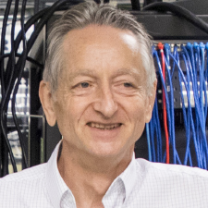
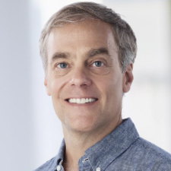
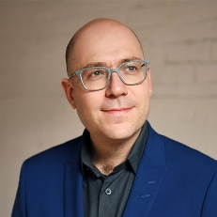

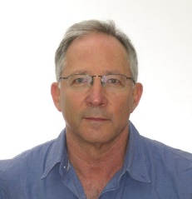
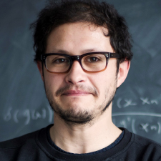
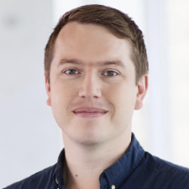
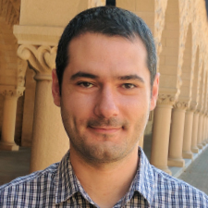
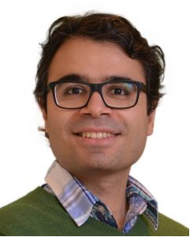
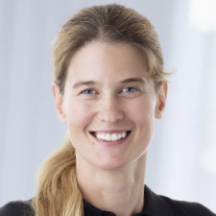
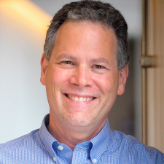
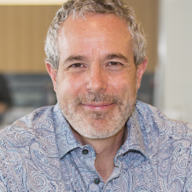
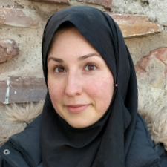
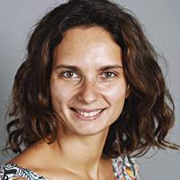
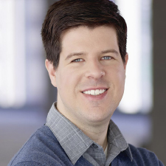
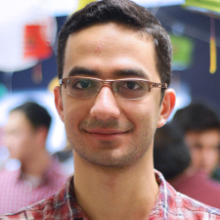
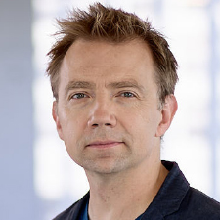
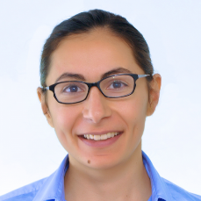
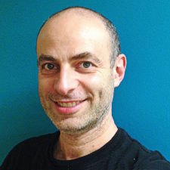
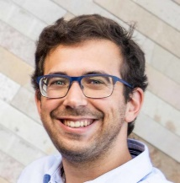
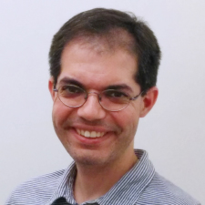
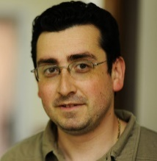
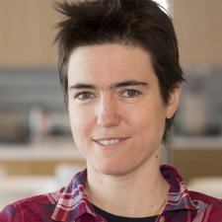
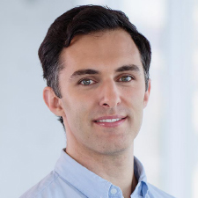
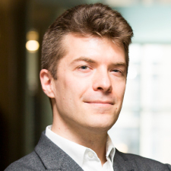
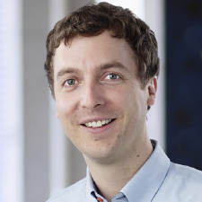
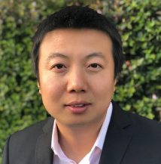
Vector Researchers
Geoffrey Hinton
Chief Scientific Advisor
Richard Zemel
Research Director
Alán Aspuru-Guzik Jimmy Ba Shai Ben-David Juan Carrasquilla David Duvenaud Murat Erdogdu Amir-massoud Farahmand Sanja Fidler
David Fleet Brendan Frey Marzyeh Ghassemi Anna Goldenberg Roger Grosse Alireza Makhzani Quaid Morris Sara Mostafavi
Sageev Oore Nicolas Papernot Pascal Poupart Daniel Roy Frank Rudzicz Leonid Sigal Graham Taylor Raquel Urtasun Bo Wang
Over the next few years it is expected that Vector will grow to include several hundred researchers, students, engineers and others.

Slide 14
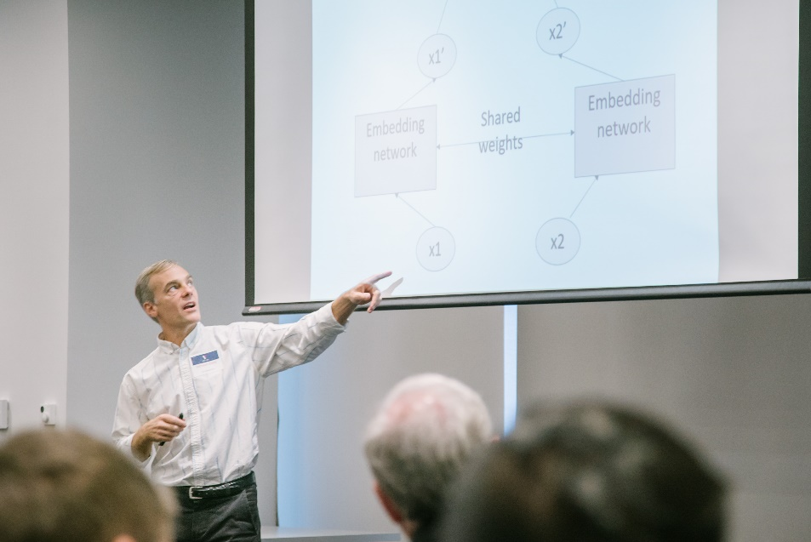
Appointments and Affiliations
Vector researchers have appointments in several Canadian institutions.
Vector will expand its collaborative network with affiliates from Canadian universities, institutions, and industry, as well as students who are enthusiastic about sharing and gaining expertise.
“Here in Canada, and especially in Toronto, we have a strong history of research in machine learning and deep learning. With the Vector Institute, we are building on those strengths and seizing a moment in which top talent and businesses want to come to Canada to advance artificial intelligence. As Research Director, my top priority since Vector’s launch has and continues to be to build a talented, collaborative team. I am thrilled that we are continuing to grow a diverse team of faculty committed to making Vector a global leader in AI.”
- Richard Zemel, Research Director
Research Affiliations
University of Toronto
Dalhousie University
University of Guelph
McMaster University
Peter Munk Cardiac Centre
SickKids Research
University of Waterloo
Western University
York University

Slide 15
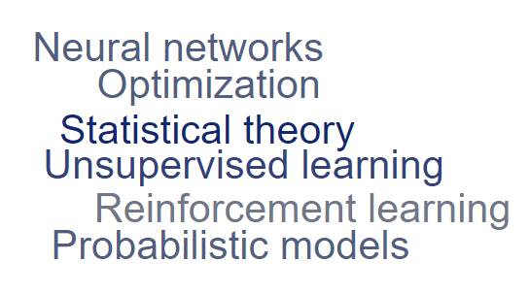
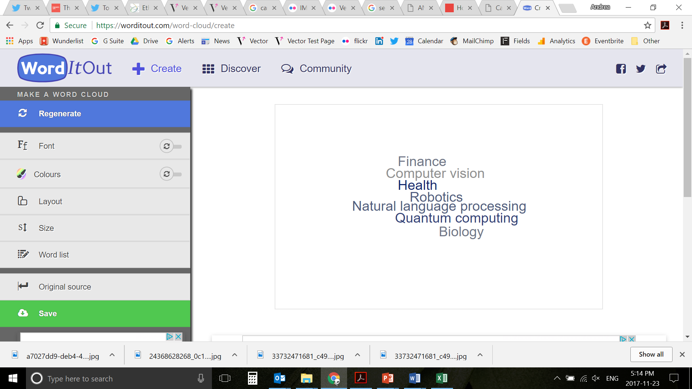
Pure and Applied Research
Our researchers are part of a vibrant community, working across disciplines on curiosity-driven and applied research. They’re at the leading edge of deep learning and machine learning in many areas.

Slide 16


Real World Problems and Data
In addition to advancing foundational research, Vector researchers have the opportunity to interact with Vector’s industry sponsors where their interests are aligned. Businesses are eager to share their technical challenges to stimulate Vector research and increase its applicability.
Data
Endless Summer School
Vector has plans to host data from Vector’s sponsors for research purposes. Researchers will be able to access this data to apply machine and deep learning techniques, train systems, and extract valuable insights.
Vector’s flagship Endless Summer School program – a collaborative, interactive lecture series – brings together engineers, computer scientists and other technically-skilled professionals from Vector’s industry sponsors to learn about the latest advances in AI research.

Slide 17
Integrating Industry into the Ecosystem
The Vector Institute is ramping up its academic and industry programming.
Current & Planned Activities
Machine Learning Advances and Applications Seminar
  The seminar regularly brings together hundreds
  of students and researchers who come to hear
  from the world’s top academic and industrial
  data scientists in machine learning and AI.
Pitch Days
  Networking event where smaller AI companies present their capabilities to Vector’s enterprise-level sponsors
Industry Training
  Providing support to enable companies to strategize around AI
  Training programs for industry professionals to go back to school for a short time and specific courses
Recent speakers:
Pieter Abbeel , University of California, Berkeley
David Blei, Columbia University
Rob Fergus, New York University / Facebook
Alex Graves, DeepMind
Geoffrey Hinton, Google/Vector Institute/University of Toronto
Hugo Larochelle, Google Brain
Jennifer Listgarten, Microsoft Research
David Sontag, MIT
Richard Sutton, University of Alberta
Max Welling, University of Amsterdam

Slide 18
Industry Sponsors
Vector’s industry sponsors reflect the broad, transformational potential of deep learning and machine learning and represent sectors as diverse as health care, finance, insurance, education, retail, advanced manufacturing, construction and transportation. Vector’s sponsors are Canadian companies or international companies with a Canadian research presence.
They are active in the AI community and are eager to learn about what AI can do for their businesses.
PLATINUM | GOLD | SILVER | BRONZE
Founding Accenture BMO Google Loblaw Companies Limited NVIDIA RBC Scotiabank Shopify Inc. TD Bank Group Thomson Reuters Uber | Founding Air Canada CIBC CN Deloitte EY Georgian Partners Intact Financial Corporation KPMG Magna International Manulife PwC Canada Sun Life Financial TELUS Thales | Founding EllisDon Corporation Linamar Corporation | Founding Chan Zuckerberg Initiative (formerly Meta) Clearpath Deep Genomics Dessa FreshBooks integrate.ai Layer 6 AI ROSS Intelligence North Wattpad 2018 Stradigi AI Wysdom AI Tealbook MindBridge
Canvass
Surgical Safety Technologies
Benchsci

Slide 19
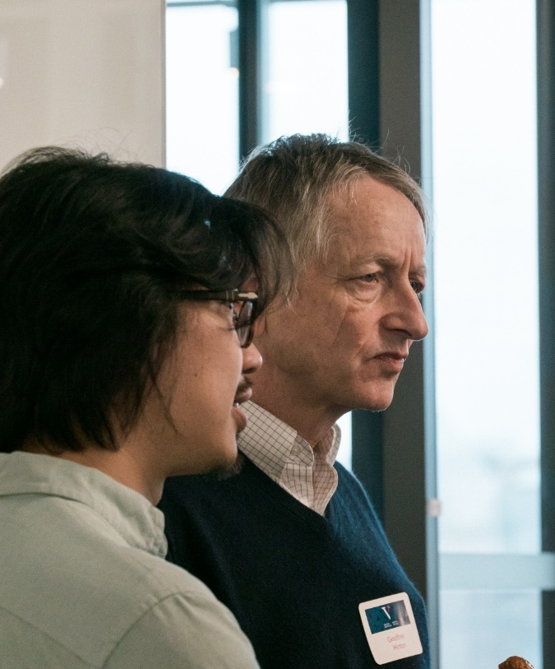
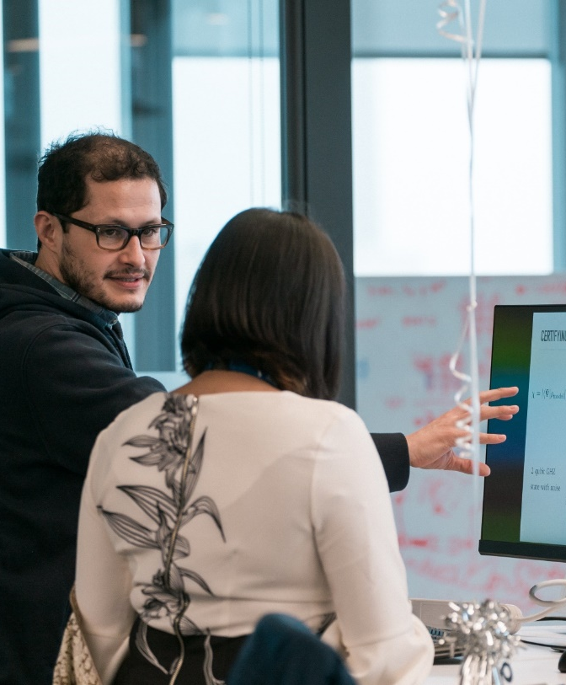
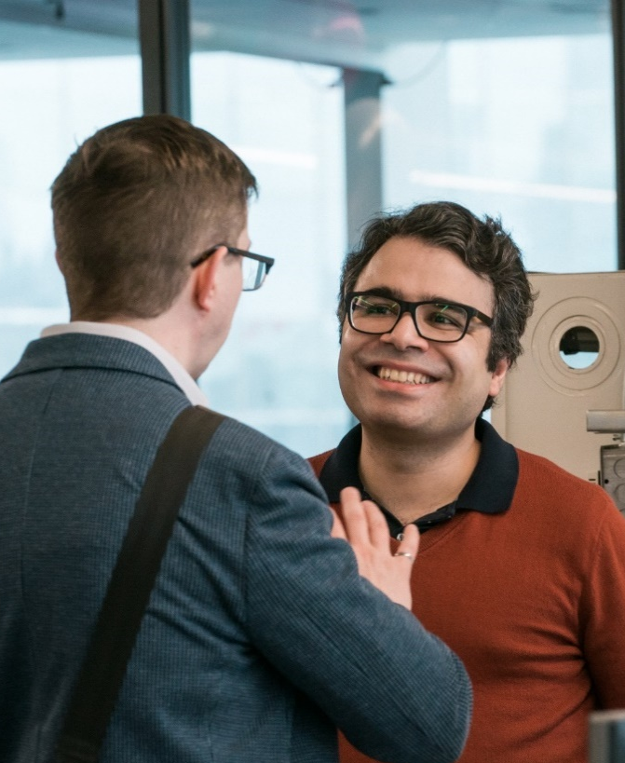
RAISE – Catalyst for workforce development
AI Education Program & Scholarships
Talent Placement via Internships
Networking and Community Building

Slide 20
Come Join Us!
Research Scientists & Postdoctoral Fellows
The Vector Institute is building its team of Research Scientists and Postdoctoral Fellows who will have opportunities to contribute by:
working and collaborating with other members of the Institute
engaging in state-of-the-art research
publishing at the highest international level
contributing to the academic life and reputation of the Institute
determining strategic areas of research
Vector also encourages its team to:
develop entrepreneurial activities and interact with industry
teach at summer schools offered by the Institute
teach graduate and undergraduate courses at a university
Students
Students affiliated with the Vector Institute will be full-time graduate students at an affiliated Canadian university. The Vector Institute is not a degree-granting institution. Vector will partner with universities towards a goal to graduate 1,000 professional applied Master’s students in AI-related fields in Ontario per year within five years.

Slide 21
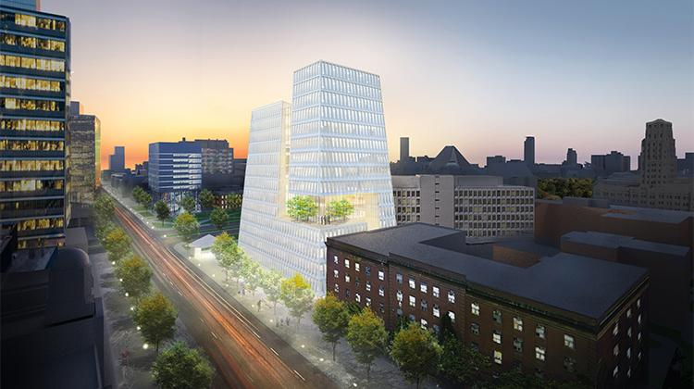
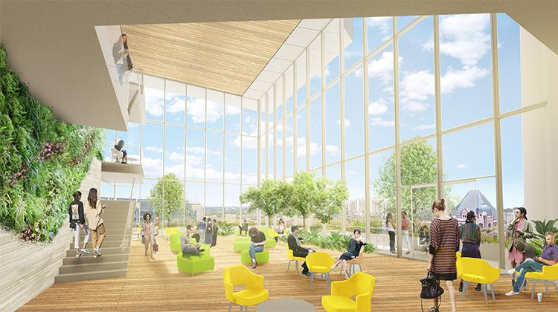
Future Office Space
Vector is growing rapidly. To accommodate our expanding team of faculty researchers and staff we are securing potential new office space.
The University of Toronto Partnership in Innovations and Entrepreneurship Complex has been identified as a possible future location for Vector Institute.

Slide 22
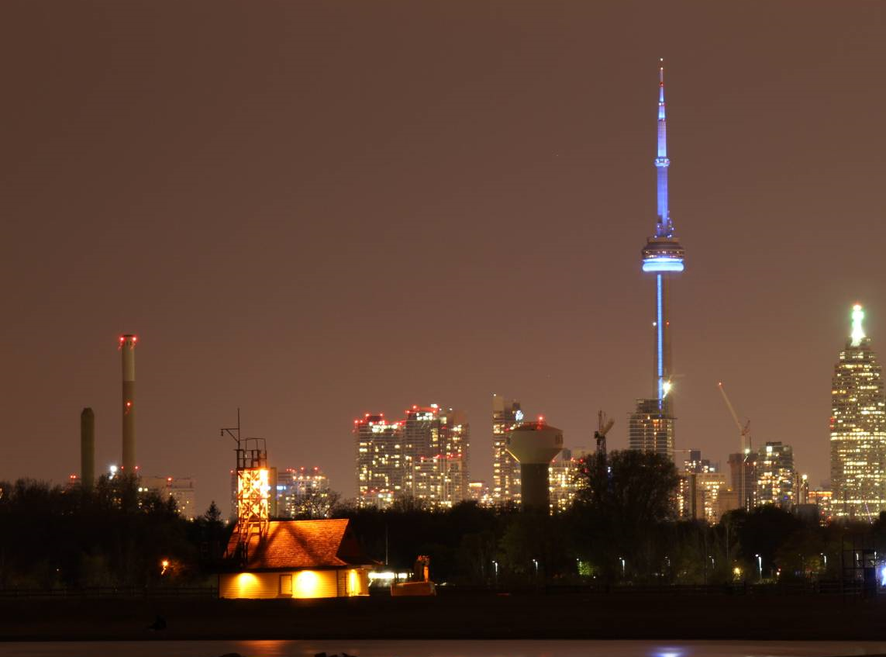
  Toronto: “The Views are Different Here”
  The most diverse population in the world. More than half of the region’s 6.4 million residents are foreign-born – a higher percentage than most global cities, including New York.
  The Toronto-Waterloo Innovation Corridor employs 205,000+ tech workers, second only to Silicon Valley in North America.
  Leading North America on almost every important quality of life metric: safety, crime, healthcare, education, housing, culture, and entertainment.
  Highly connected across all modes of transportation: plane, train, car, subway, or bike. Huge volumes of people move efficiently across all transit options every day, multiplying possibilities when it comes to choosing where to live.
  Toronto’s Pearson International Airport is the second largest international airport in North America; travel to some of the largest U.S. markets, including New York, Boston, Chicago and Washington, all within a 90-minute flight.
  Welcoming more than 100,000 new immigrants every year – 40% of Canada’s total immigration inflow. Governments work in concert to encourage immigration among highly-skilled international talent.

Slide 23
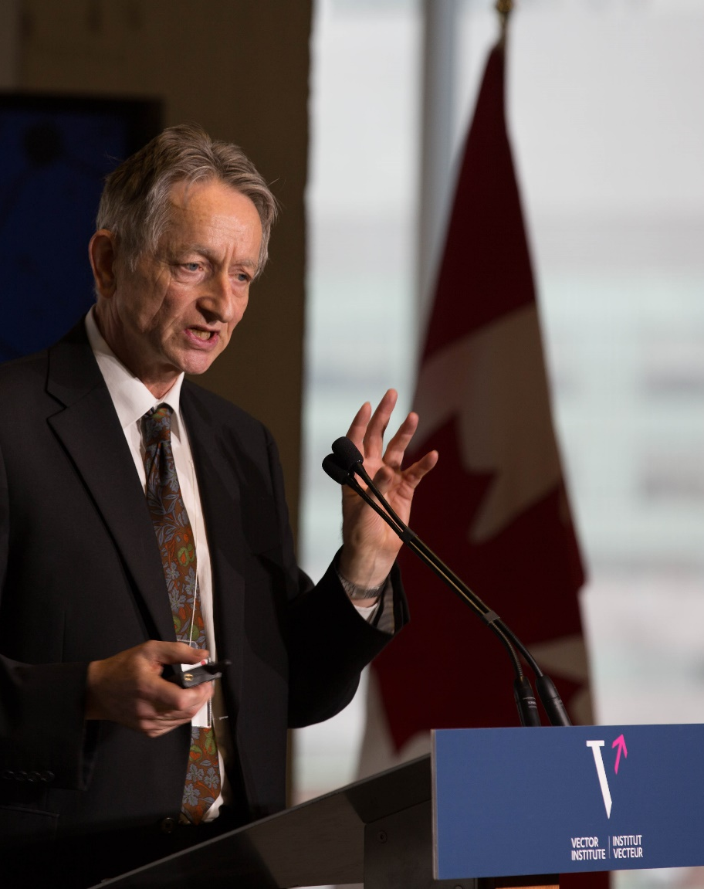
“Increasingly, the world’s most promising researchers in deep learning and other AI subfields are looking at Canada as a hub with many opportunities to collaborate, advance research and develop applications. Vector is a pillar of the Canadian AI ecosystem and I’m very excited that the team is expanding with highly sought-after talent, some of whom I’ve had the pleasure of working with. This team will drive Vector’s excellence in research, education and industry collaboration.”
- Geoffrey Hinton, Chief Scientific Advisor, Vector Institute

Slide 24
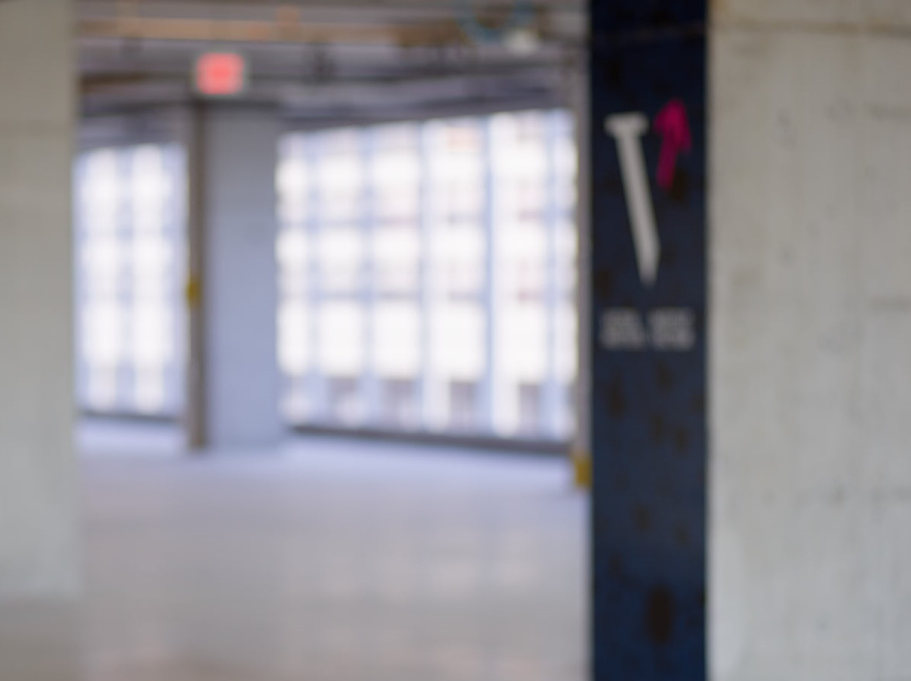
vectorinstitute.ai | @VectorInst

